Slide 1
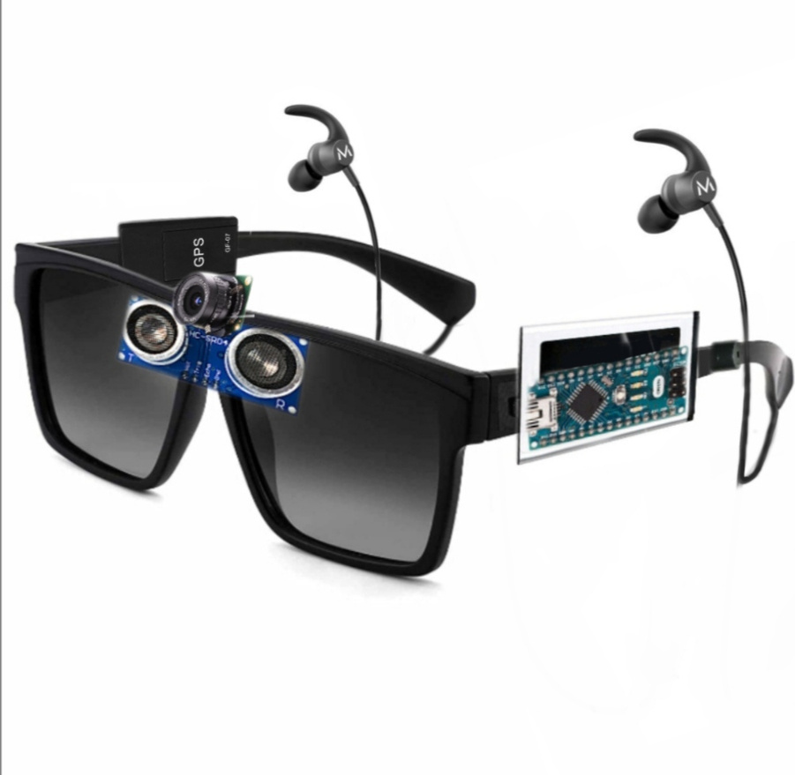
PROJECT
PROPOSAL
VisionMate
Presented By Team Al-Fatah

Slide 2

Team Al Fatah
Team Members:
Md Shazzad Hossain Jiku - 011221073
Mohammad Sameer Ahmed - 011221136
Md. Ammar Hossain - 011221601
06

Slide 3

Motivation:
Empowering the Partially Impaired Community
Bridging Technological Gaps in Accessibility
Safety and Security
Harnessing IoT and AI for Good

Slide 4
How It Will Contribute to Society
Social Inclusion
Enhanced Safety
Community Support
Encouragement for Further Innovation

Slide 5
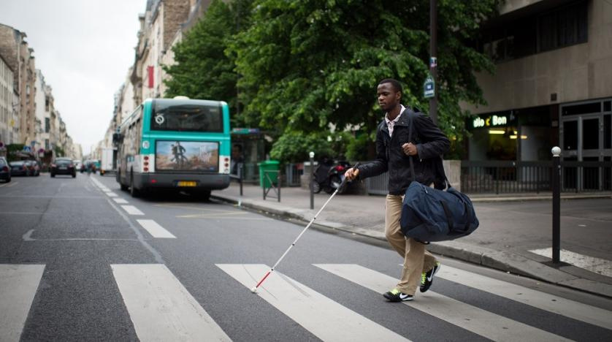
Introduction
VisionMate is an IoT-based wearable designed to assist partially impaired individuals by providing real-time navigation, obstacle avoidance, object identification, and emergency SOS alerts.
By integrating technologies like sensors, GPS, and AI, it aims to enhance safety, confidence, and independence for partially impaired individuals in their daily lives.

Slide 6
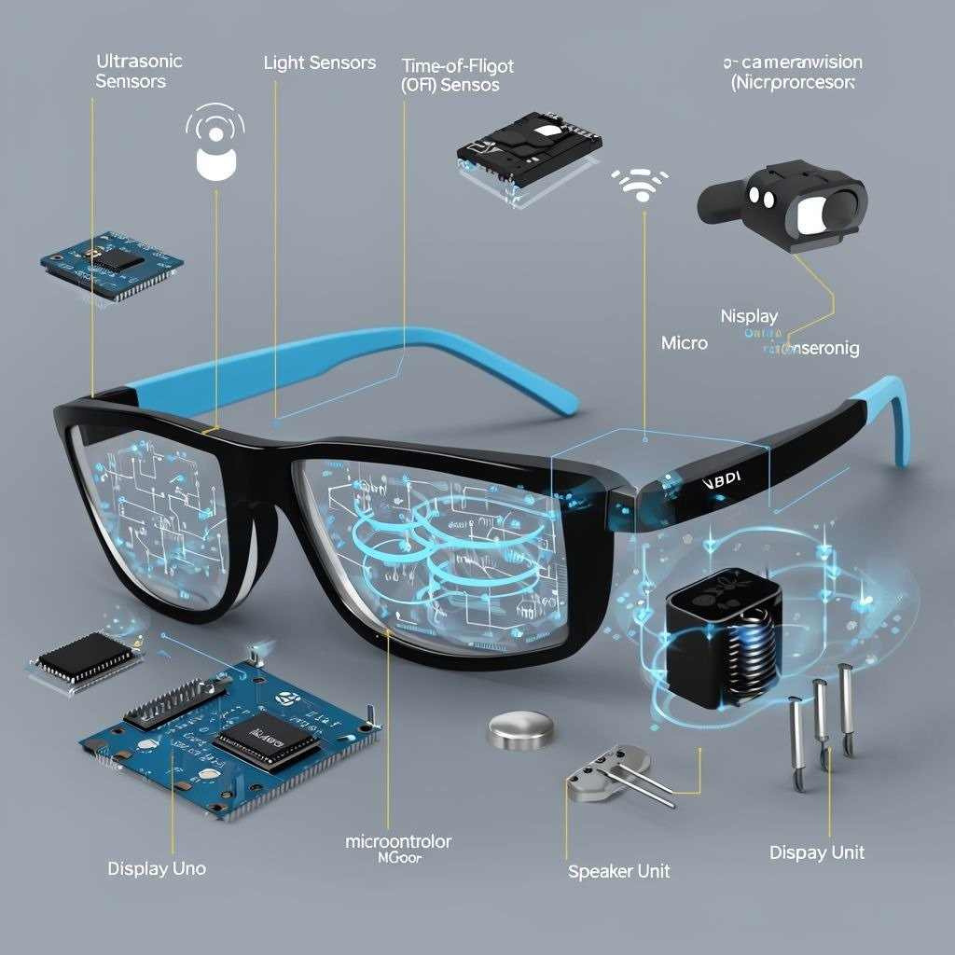
Diagram of projects VisionMate

Slide 7
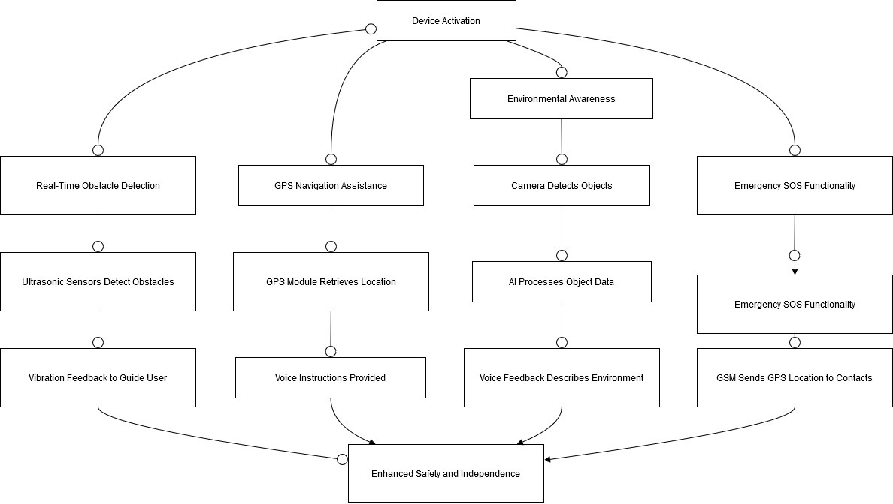
System flowchart:

Slide 8
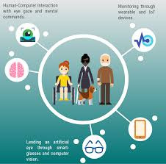
Features of VisionMate
Real-Time Obstacle Detection
GPS-Based Navigation Assistance
Environmental Awareness with Object Identification
Emergency SOS Functionality
Emergency Trigger
Battery Monitoring with Alerts

Slide 9
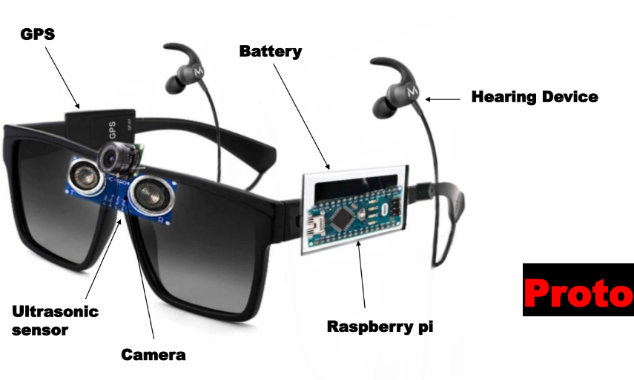
Hardware Components:
1. Microcontroller
• Raspberry Pi 4 (8 GB)
• ESP 32S
2. Sensors
• Camera sensor
• Time-of-Flight (ToF) Sensors
3. Actuator
• Vibration Motor (Coin Shape)

Slide 10
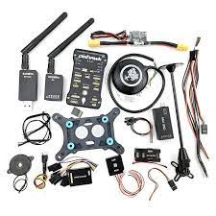
Hardware Components:
4. Display Unit
• Transparent OLED Display
5. Power Supply
• Li-ion Battery
6. GPS Module
7. Button
8. Speaker

Slide 11
THANK
YOU
Presented By Team Al-Fatah

